Slide 1


Slide 2
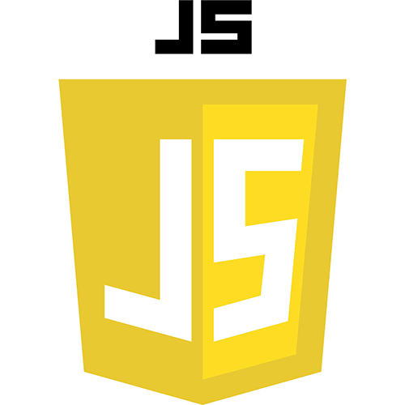

Slide 3
Install MongoDB on Mac and Windows
Build a local MongoDB database
Install npm and Node on Mac and Windows
Connect to MongoDB with a Node server, native driver and Mongoose

Slide 4
Count site visitors with MongoDB, Node, Express and EJS
Build a new MongoDB Express project
Increment counter with each visit
Build the homepage template with EJS

Slide 5
Build a CRUD app with MongoDB, EJS, Node, Express
Build web server with Node and Express
Create data with POST requests to server
Connect to MongoDB
Read and show all database items to client with EJS
Update data on the database via client
Build a delete button
Quickly style the site with Bootstrap

